Slide 1

Basic Circuit Laws and their Applications Section 2.1, 2.2, 2.3, 2.4, 2.5, 2.6
Md. Shafqat Talukder Rakin
Lecturer, Department of CSE,
United International University
Email id : shafqat@cse.uiu.ac.bd
Courtesy: Rifat Bin Rashid

Slide 2
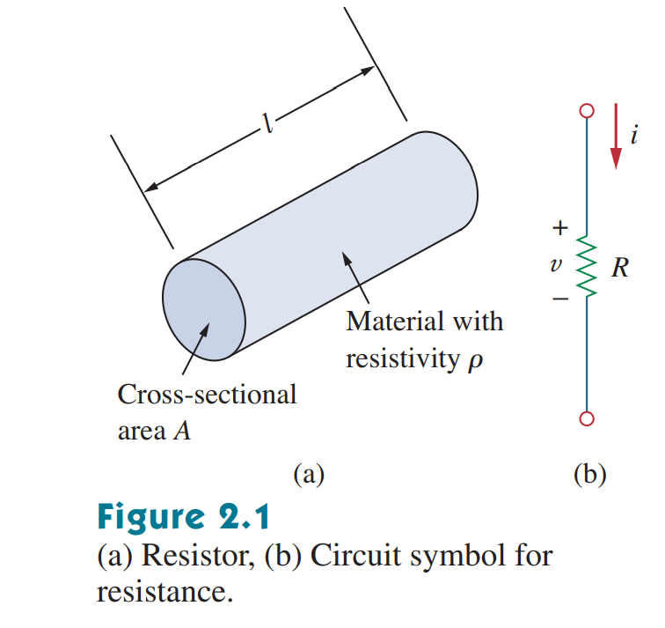
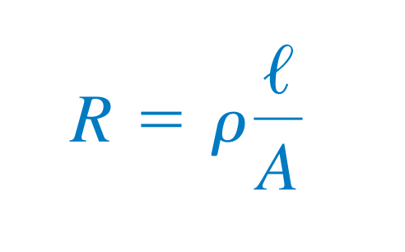
Resistance
R is resistance in ohms (Ω)
l is length of the conductor (m)
A is cross-sectional area of conductor (m²)
ƿ is Resistivity of the material
Notice the sign convention followed in the figure

Slide 3
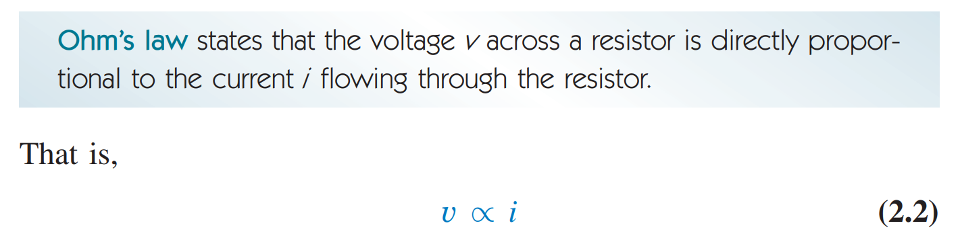
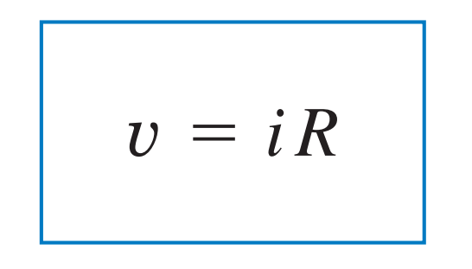
Ohm’s Law

Slide 4
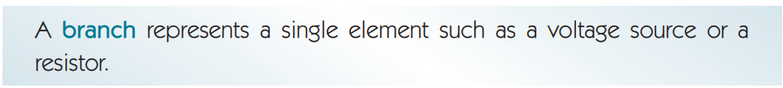
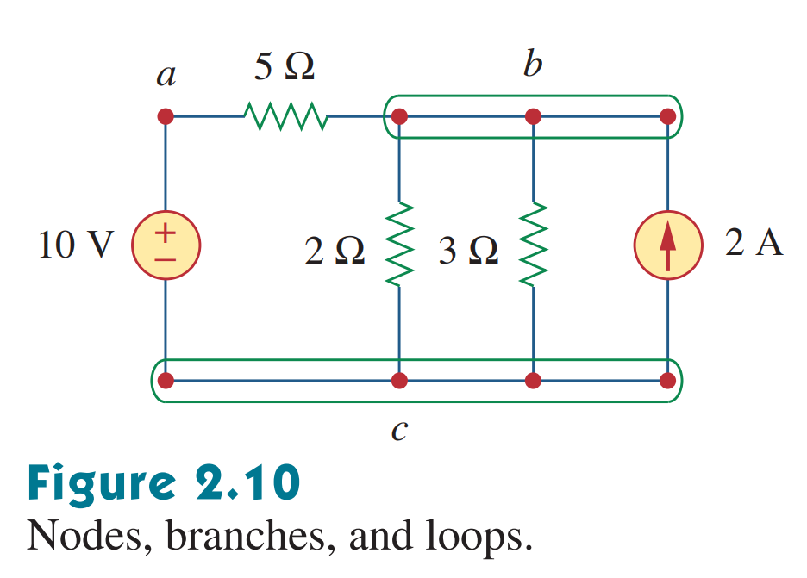
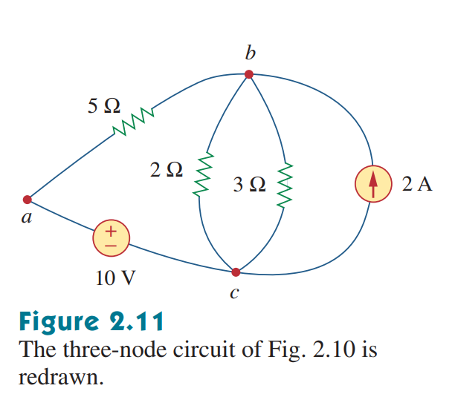
Branches and Nodes

Slide 5
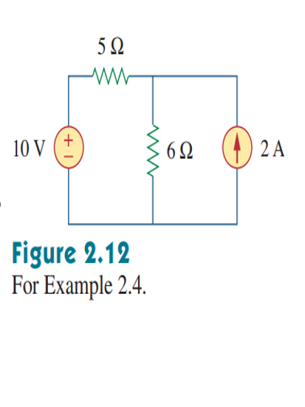
Find the nodes for this circuit

Slide 6
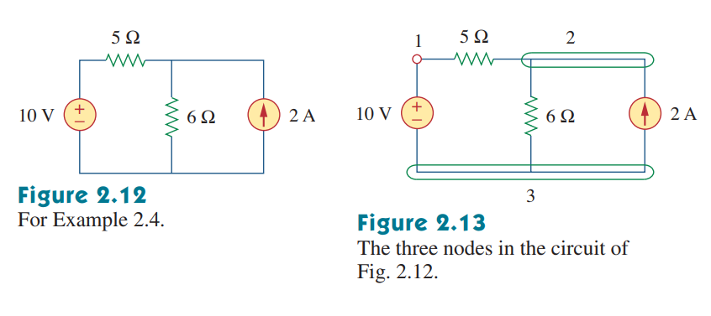

Slide 7
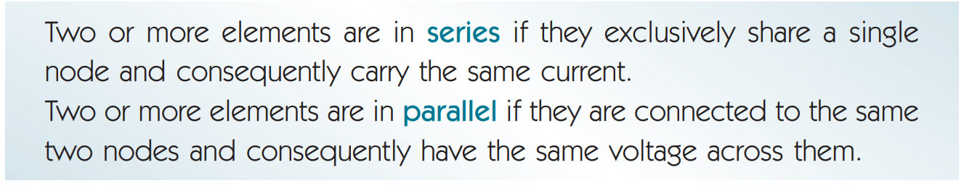
Series and Parallel Circuits

Slide 8
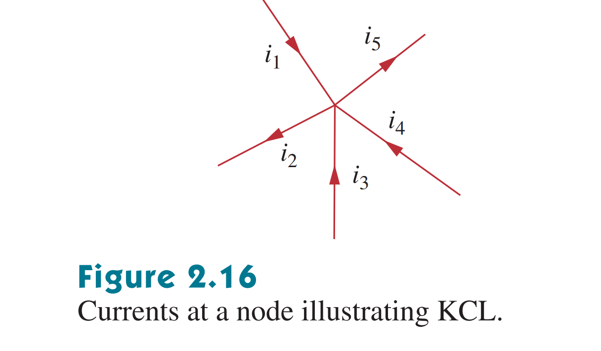

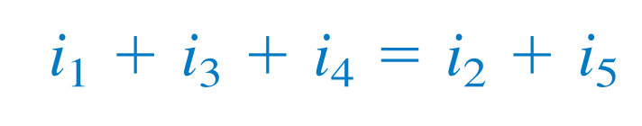
Kirchhoff's Current Law (KCL)

Slide 9
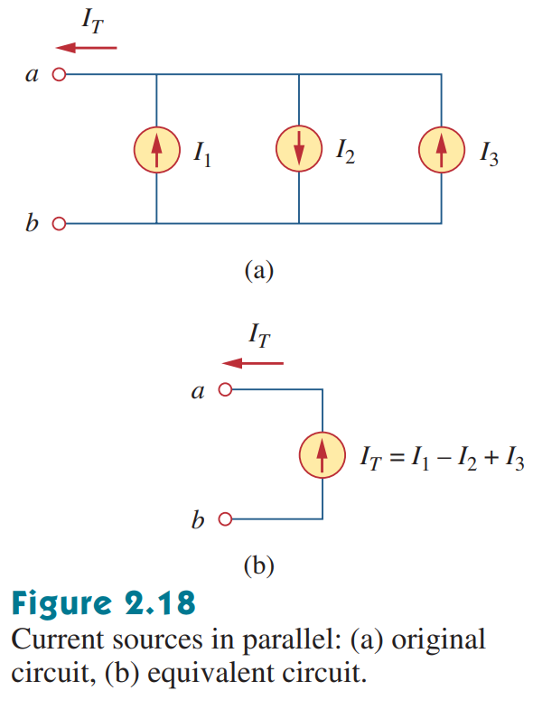
Applying KCL to Current Sources in Parallel

Slide 10
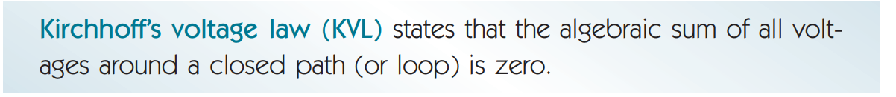
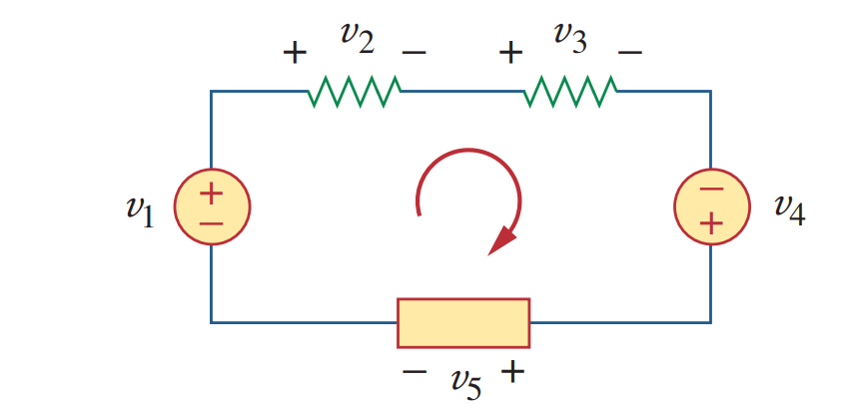

Kirchhoff's Voltage Law (KVL)
In the above example,

Slide 11
KVL Rules:
Assign currents in all the branches with suitable direction.
Name all the nodes and terminals.
Add voltage polarity (+/-) to all the elements according to assigned current direction.
Apply KVL by collecting voltages with appropriate signs along the independent loops.

Slide 12
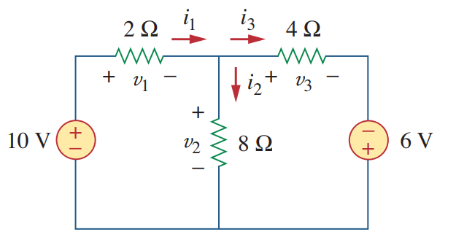
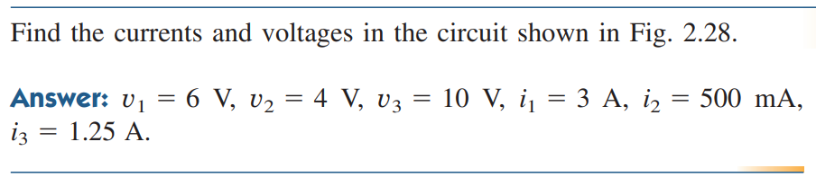
Math Problem Practice:
2.5 A
Reference: Sadiku_Practice_Problem_2.8

Slide 13
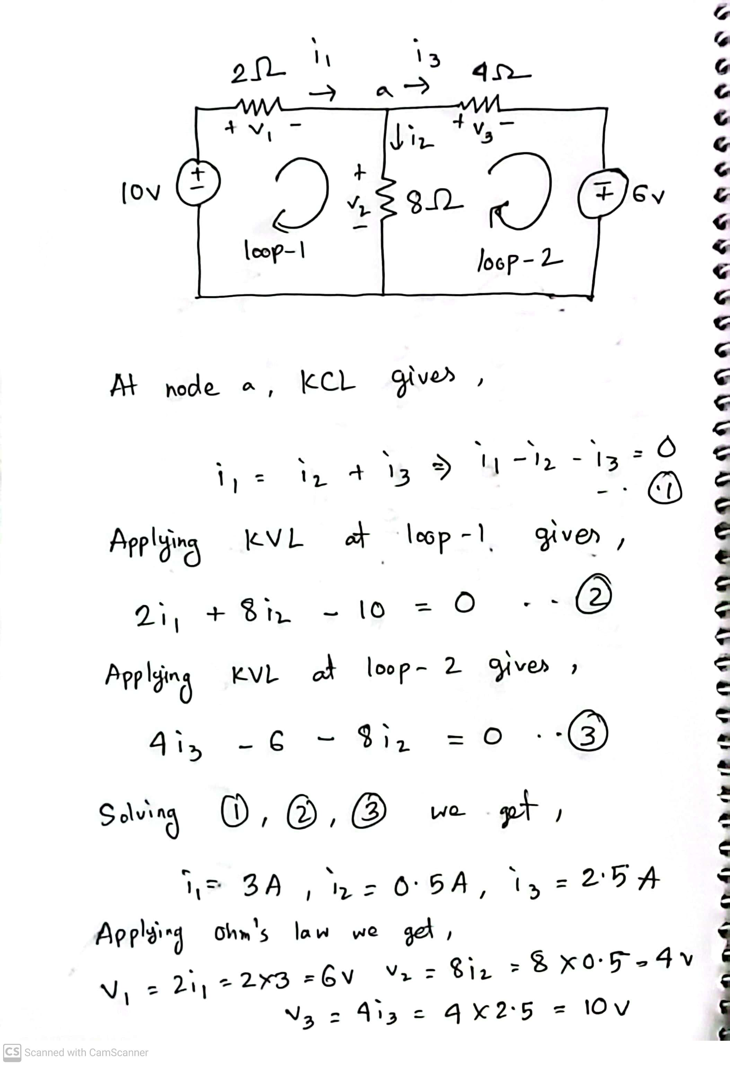

Slide 14
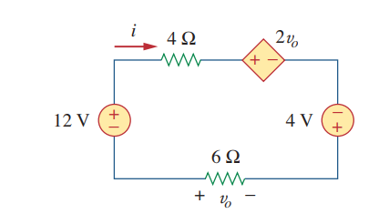
Math Problem Practice:
Reference: Sadiku_Example_2.6

Slide 15
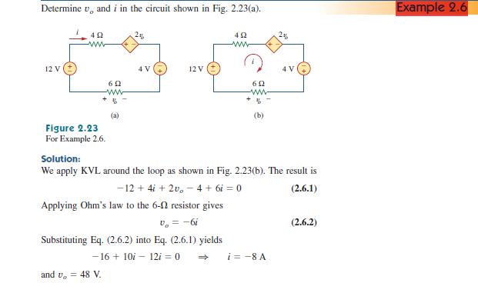
Math Problem Practice:
Reference: Sadiku_Example_2.6

Slide 16
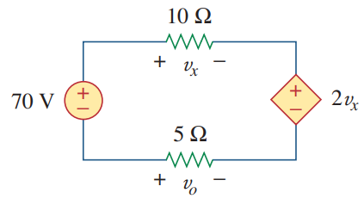
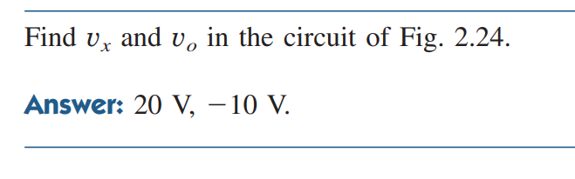
Math Problem Practice:
Reference: Sadiku_Practice_Problem_2.6

Slide 17
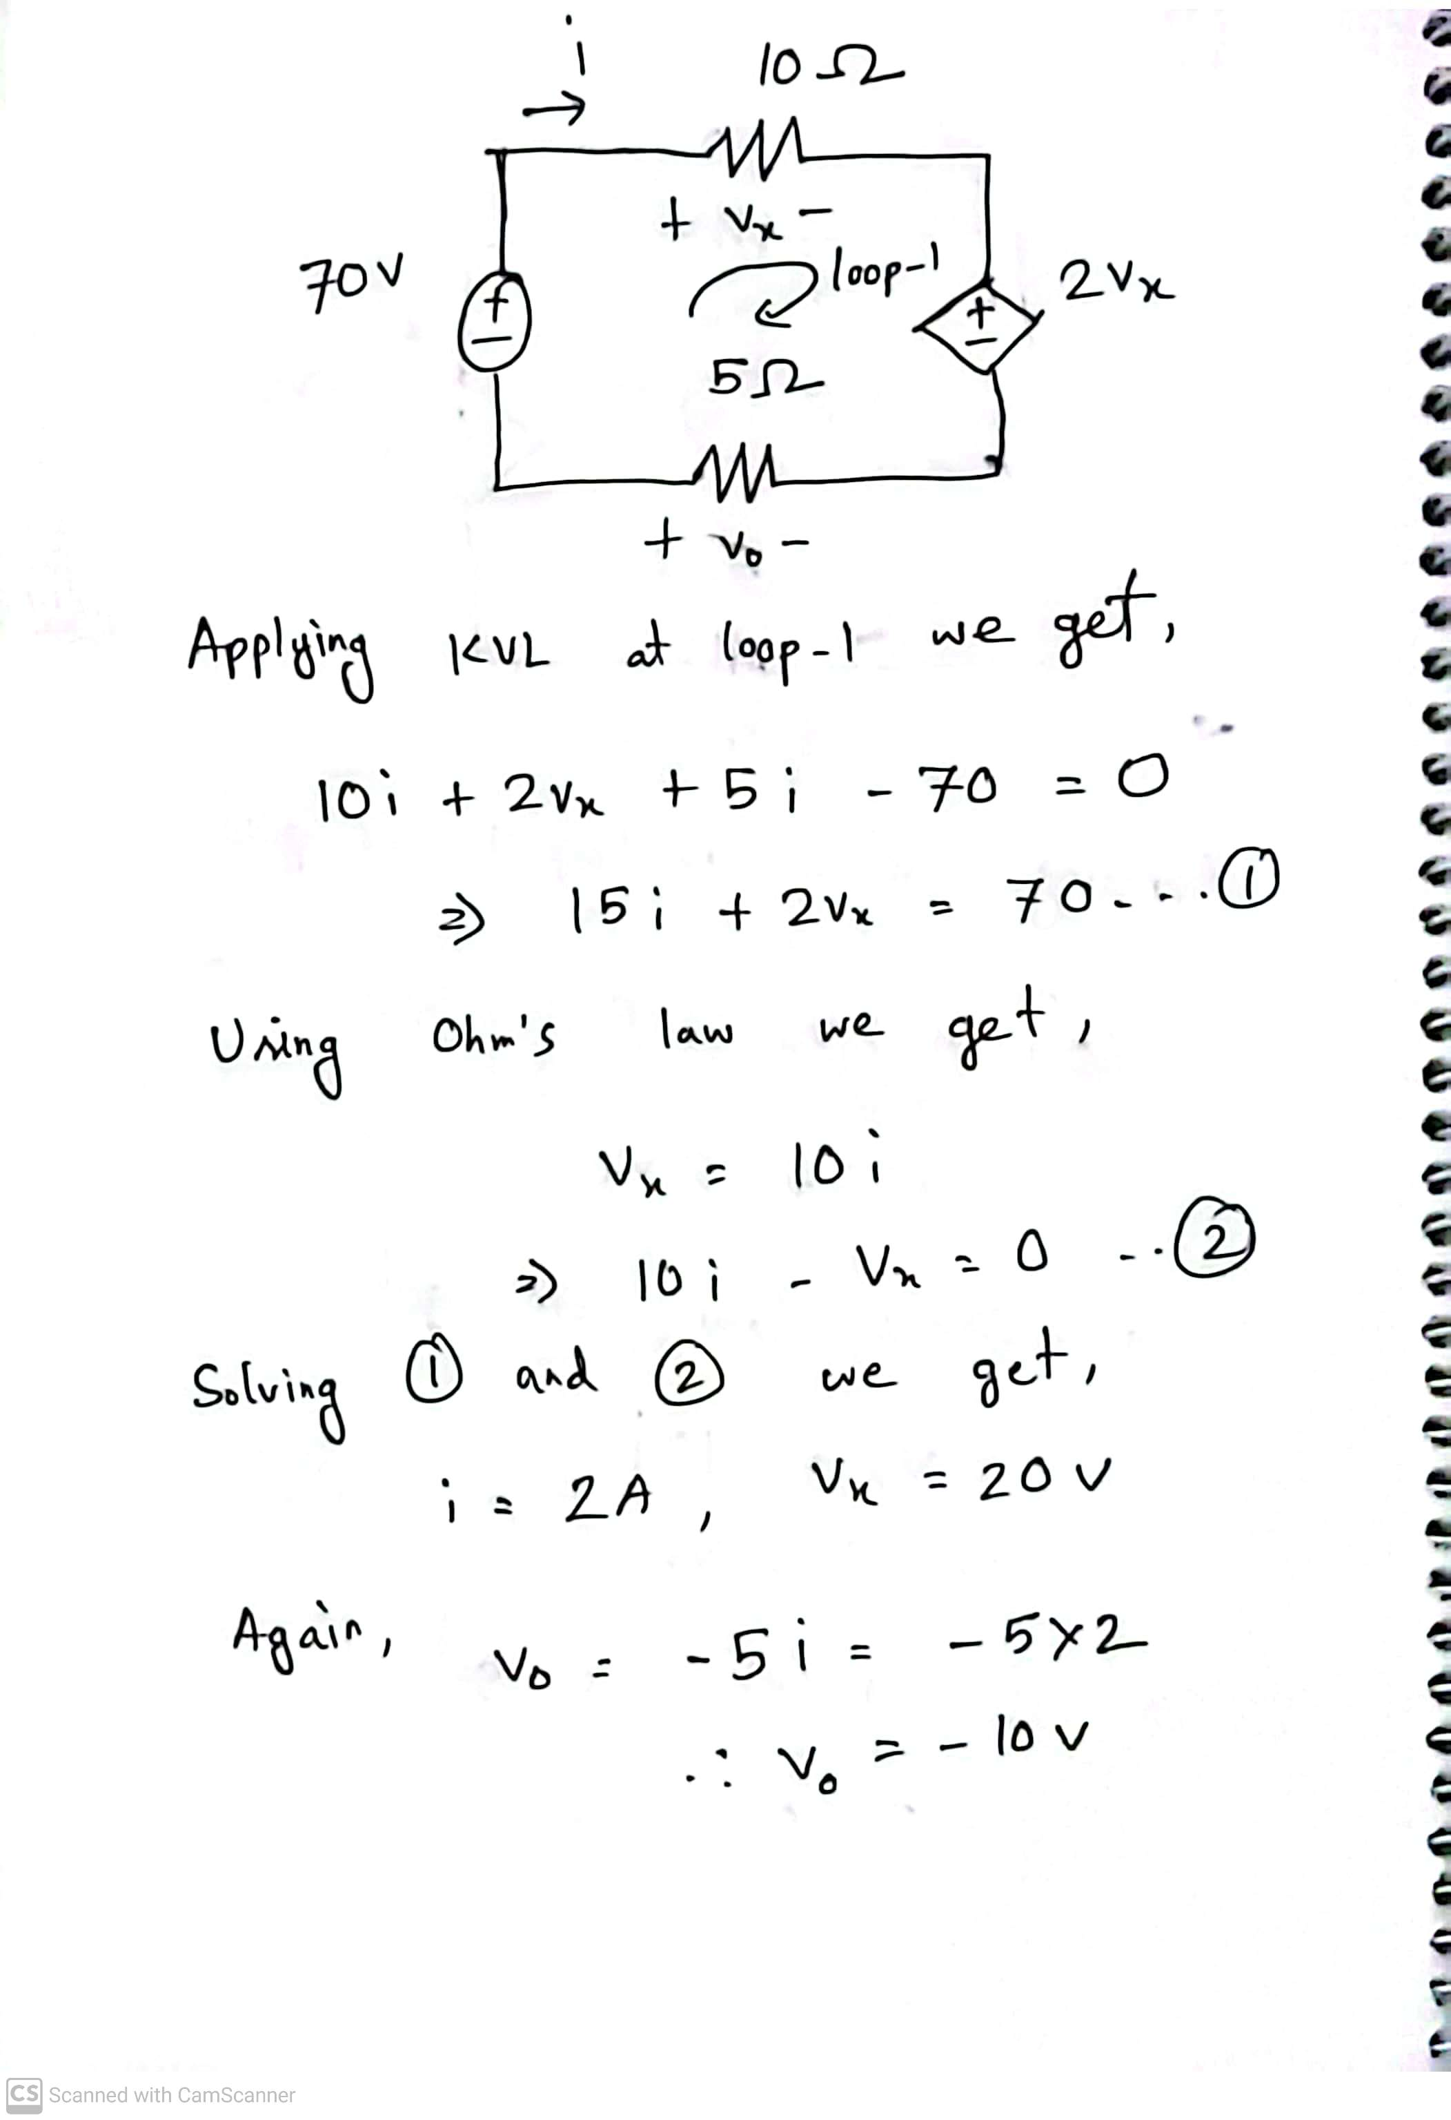
Math Problem Practice:
Reference: Sadiku_Practice_Problem_2.6

Slide 18
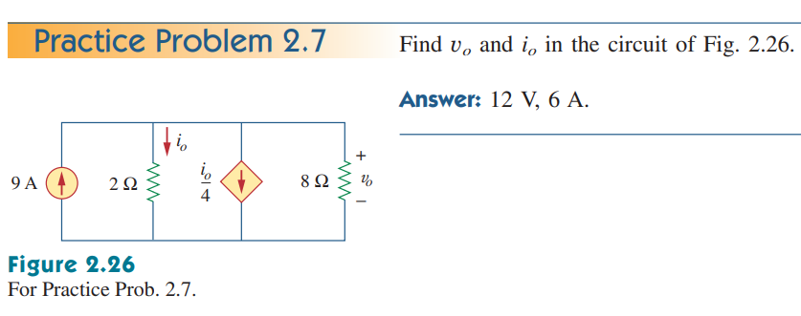
Math Problem Practice:
Reference: Sadiku_Practice_Problem_2.7

Slide 19
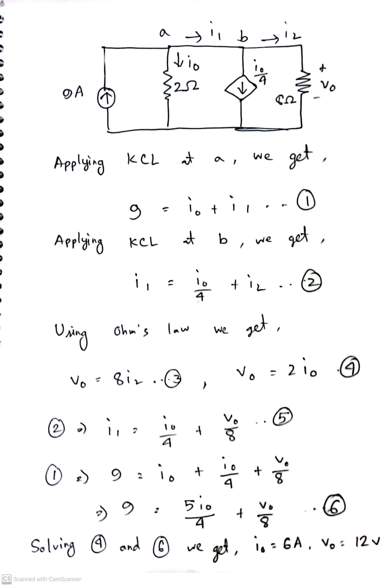
Math Problem Practice:
Reference: Sadiku_Practice_Problem_2.7

Slide 20
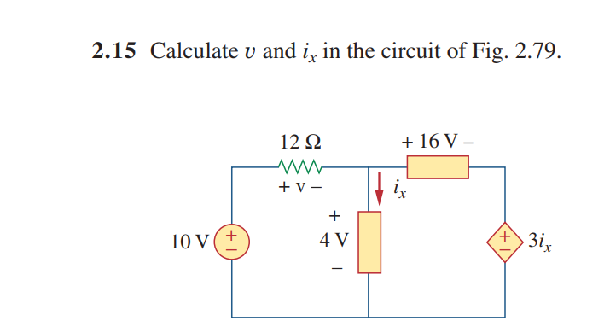
Math Problem Practice:
Reference: Sadiku_Exercise_Problem_2.15

Slide 21
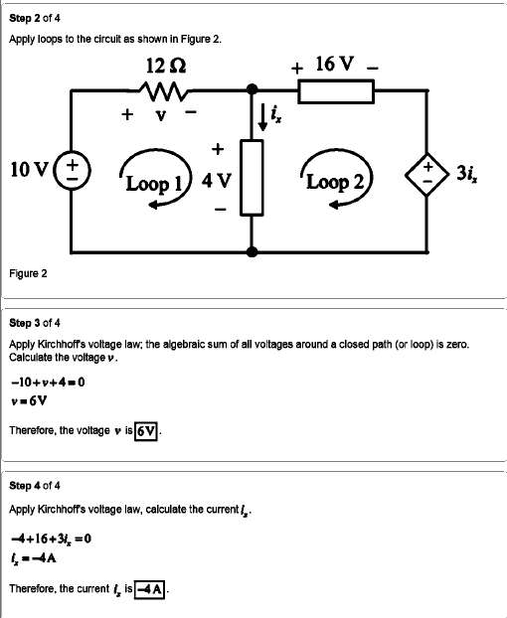
Math Problem Practice:
Reference: Sadiku_Exercise_Problem_2.15

Slide 22
Thank You

